Slide 2
Azure Deep Dive
Rob Bell

Slide 3
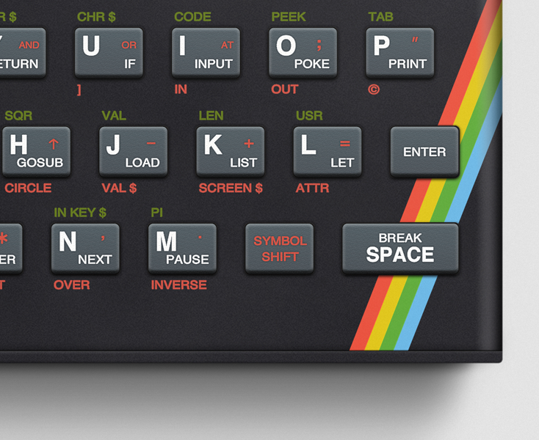
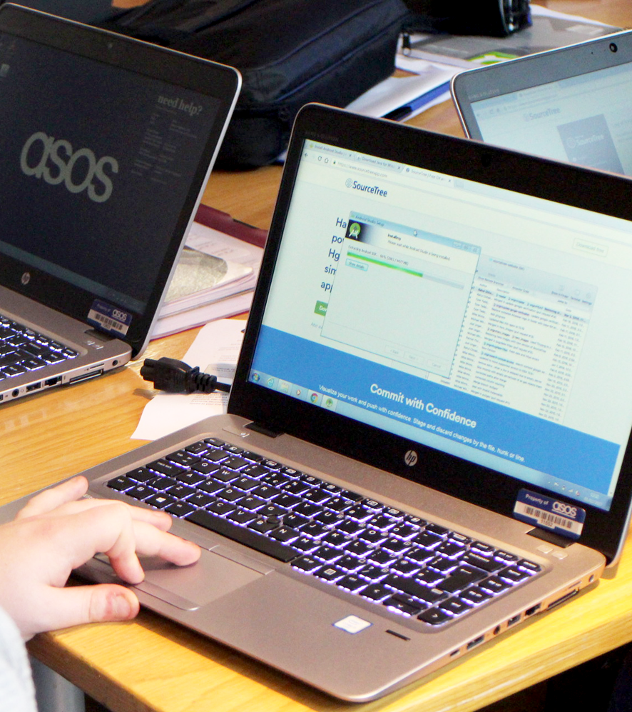
Rob Bell
Lead Software Engineer
Over 20 years writing code and over a decade as a professional developer
First code I wrote was for the ZX Spectrum
After that, I worked my way through the book The C Programming Language
Built HTML web pages in Microsoft Frontpage on my first PC
Since then I’ve written code in C++, Java, JavaScript, PHP, Delphi, Coldfusion, C#, VB, Scheme, F#...
Notes:
Over 20 years writing code and over a decade as a professional developer
I first wrote code for my uncle’s ZX Spectrum, in a language called Basic
I worked my way through the book The C Programming Language, I wrote code samples on pencil and paper as I didn’t have a computer at the time
When I finally did get my first PC, I built web pages in HTML using Microsoft Frontpage
Since then I’ve written code in C++, Java, JavaScript, PHP, Delphi, Coldfusion, C#, VB, Scheme, F#...

Slide 4

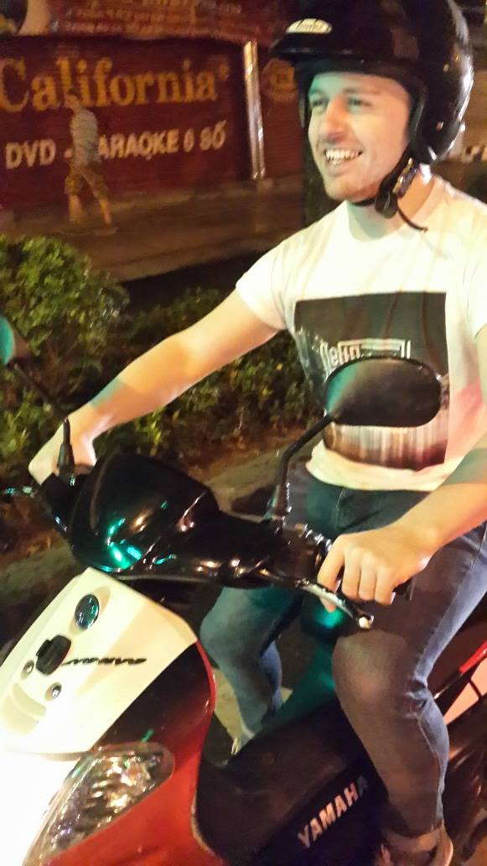
Rob Bell
Lead Software Engineer
My first job as a developer was for a media company, before moving into the insurance and finance sector
Built a software development team in Vietnam
Moved back home and had a brief stint as a technical architect
Moved to ASOS where I work for the Asset and Sizing platforms
Notes:
My first job was for a small media company which was also a charity
Small team of 3 devs, great freedom to build whatever we thought would help the organisation
Podcasting, with audio coming straight from the studios
After that I moved into insurance and finance
Code audits, lots of bureaucracy
After a few years there I got the opportunity to start a development team in Vietnam

Slide 5
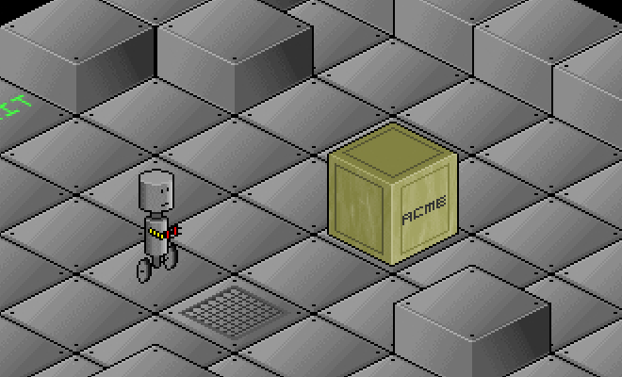
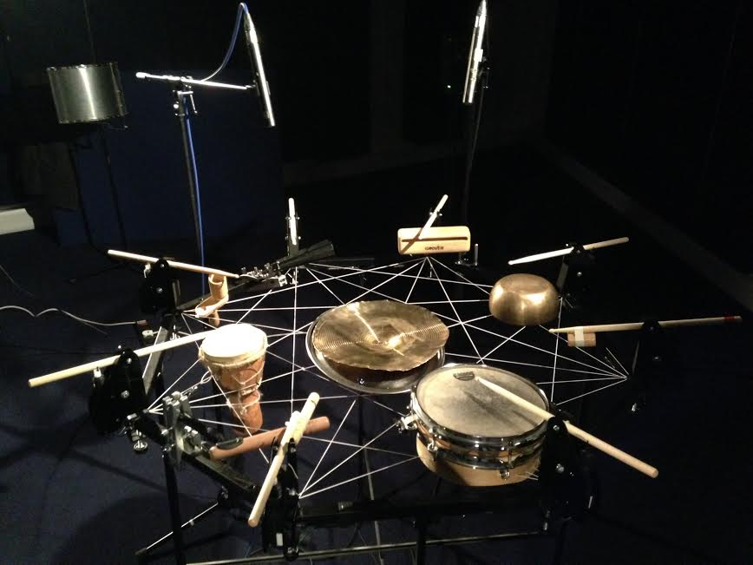
Rob Bell
Lead Software Engineer
In my spare time I’ve built games and I’ve written code to power sound and light installations and robot drum machines
I blog about some of it at rob-bell.net
Notes:
In my spare time I’ve built games and I’ve written code to power sound and light installations and robot drum machines
The game is called Rob-O-Tronic and it’s a slide puzzle, written as part of my dissertation at university
The drum machine was programmed by visiting a website and entering a musical score
It was on display at the Natural History Museum and the V&A
I blog about some of it at rob-bell.net

Slide 6
Part 1: Azure Resources

Slide 7
Why use the cloud?
“Cloud computing is just using somebody else’s computers”
Notes:
Put the question out to the team
It is correct, but a very simplistic view
Cloud computing provides so much more

Slide 8
Information technology as a utility, not a burden
Notes:
Electricity as an example

Slide 9
Why use the cloud?
Availability
Flexibility
Security
Maintenance
Notes:
Flexibility – both scalability (up and down, out and in) and density options

Slide 10
Why use the cloud?
AI
Intelligent Services
Other things

Slide 11
Why Azure?
“Microsoft are money-grabbing *********s”

Slide 12
Why Azure?
Familiarity
Cost
Resources

Slide 13
Compute Options

Slide 14
CosmosDB

Slide 15
Service Bus

Slide 16
App Insights

Slide 17
Other things

Slide 18
Labs

Slide 19
Part 2: Cloud Design Patterns

Slide 21
Labs

